Slide 1
Quantum Ripple Adder

Slide 2
What is Ripple Adder
A ripple carry adder is a digital circuit that adds two binary numbers by cascading full adders. The "ripple" refers to how the carry bit propagates from the least significant bit (LSB) to the most significant bit (MSB), like a ripple effect.
Key Components:
Full Adder: Adds three bits (A, B, and carry-in) to produce a sum and carry-out
Half Adder: Adds two bits (used only for the LSB position when there's no initial carry)
Carry Chain: The carry-out from each stage becomes the carry-in for the next stage

Slide 3
Gate Definitions and Roles
Gate Definitions and Roles
Quantum Gates Used:
CNOT (Controlled-X) Gate:
Flips the target qubit if the control qubit is |1⟩
Used for XOR operations and entanglement
Essential for implementing classical XOR logic
Toffoli (CCX) Gate:
Three-qubit gate that flips the target if both control qubits are |1⟩
Implements classical AND logic
Used to generate carry bits
X Gate:
Bit flip gate (NOT operation)
Used for input preparation and corrections

Slide 4
How it Works?
How the Ripple Carry Adder Works
The ripple carry adder operates by implementing the classical binary addition algorithm:
Bit-by-bit Addition: Starting from the least significant bit (LSB), each position adds:
Bit from first number (A)
Bit from second number (B)
Carry from previous position
Full Adder Logic: For each bit position:
Sum bit: S = A ⊕ B ⊕ Carry_in
Carry out: Carry_out = (A ∧ B) ∨ (Carry_in ∧ (A ⊕ B))
Carry Propagation: The carry-out from position i becomes the carry-in for position i+1

Slide 5
Quantum Implementation Details
Qubit Allocation:
a[0 : n-1]: First input number qubits
b[0 : n-1]: Second input number qubits
c[0 : n]: Carry qubits (including final carry-out)
s[0 :n-1]: Sum result qubits
Gate Operations:
CX gates create the XOR operations needed for sum calculation
CCX (Toffoli) gates generate carry bits using AND logic
Barrier instructions organize the circuit for clarity

Slide 6
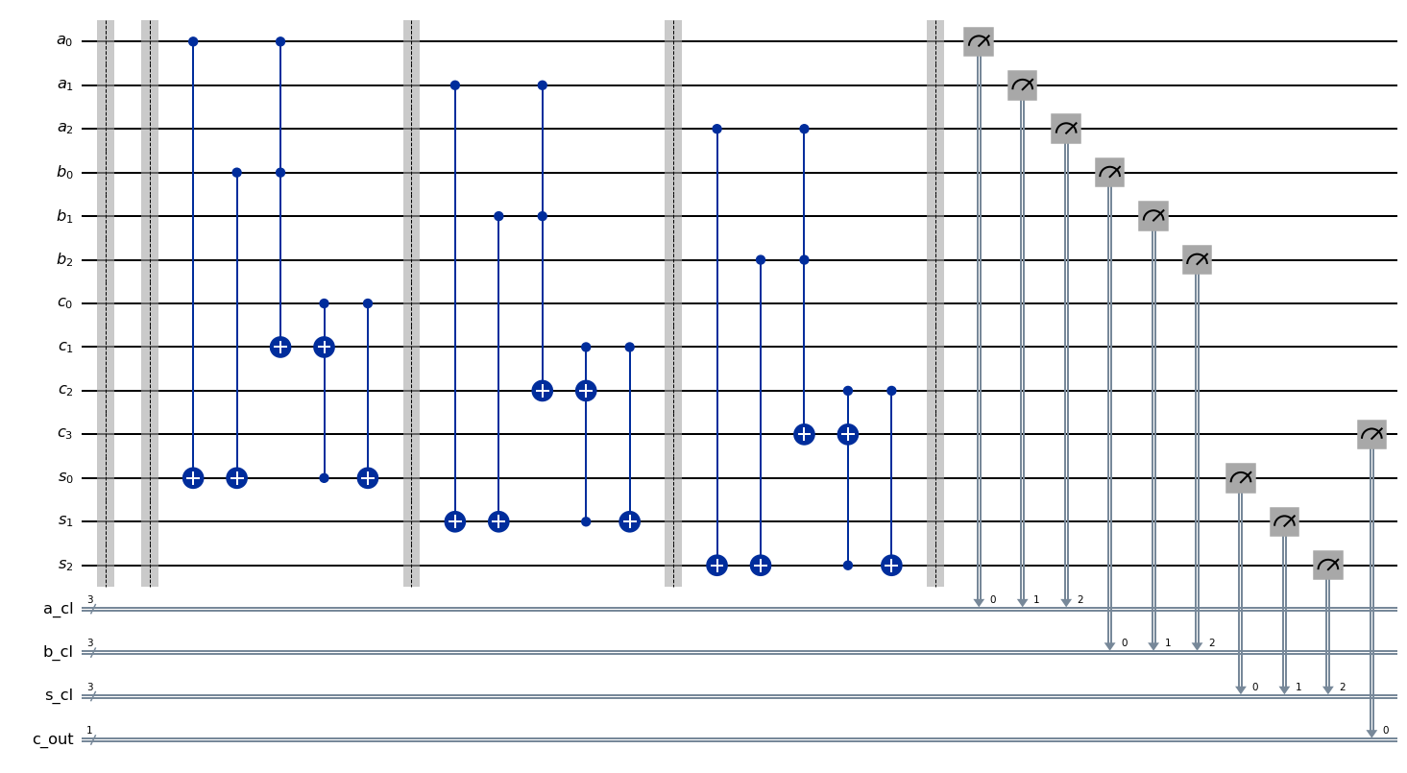
Circuit Diagram

Slide 7
Init
def __init__(self, n_bits=3):
"""
Initialize the quantum ripple adder
Args:
n_bits (int): Number of bits for each input number
"""
self.n_bits = n_bits
self.circuit = None
self.create_adder_circuit()

Slide 8
Create Adder Circuit
Create the quantum ripple carry adder circuit
Qubit allocation:
- a[i]: First input number (bits 0 to n-1)
- b[i]: Second input number (bits 0 to n-1)
- c[i]: Carry bits (bits 0 to n, where c[0] is carry-in, c[n] is final carry-out)
- s[i]: Sum output bits (bits 0 to n-1)

Slide 9
Create Circuit
def create_adder_circuit(self):
# Create quantum registers
a = QuantumRegister(self.n_bits, 'a') # First input
b = QuantumRegister(self.n_bits, 'b') # Second input
c = QuantumRegister(self.n_bits + 1, 'c') # Carry bits (including carry-out)
s = QuantumRegister(self.n_bits, 's') # Sum output
# Classical registers for measurement
a_cl = ClassicalRegister(self.n_bits, 'a_cl')
b_cl = ClassicalRegister(self.n_bits, 'b_cl')
s_cl = ClassicalRegister(self.n_bits, 's_cl')
c_out_cl = ClassicalRegister(1, 'c_out')
# Measure all qubits
self.circuit.measure(a, a_cl)
self.circuit.measure(b, b_cl)
self.circuit.measure(s, s_cl)
self.circuit.measure(c[self.n_bits], c_out_cl) # Final carry-out

Slide 10
Create Circuit ….
# Create the circuit
self.circuit = QuantumCircuit(a, b, c, s, a_cl, b_cl, s_cl, c_out_cl)
# Add a barrier for clarity
self.circuit.barrier()
self.circuit.label = "Input Preparation"
# Implement the ripple carry adder logic
for i in range(self.n_bits):
self.add_full_adder(i, a, b, c, s)
# Add final barrier
self.circuit.barrier()

Slide 11
Full Adder
Add a full adder for the given bit position
Full Adder Logic:
sum = a ⊕ b ⊕ carry_in
carry_out = (a ∧ b) ∨ (carry_in ∧ (a ⊕ b))
Quantum Implementation:
1. Compute a ⊕ b and store in sum qubit
2. Compute carry_out using Toffoli gates
3. Apply final XOR with carry_in to get final

Slide 12
Full Adder
ddef add_full_adder(self, bit_position, a, b, c, s):
i = bit_position
# Label this section
self.circuit.barrier()
# Step 1: Compute a[i] ⊕ b[i] → s[i]
self.circuit.cx(a[i], s[i])
self.circuit.cx(b[i], s[i])
# Step 2: Compute carry_out = (a[i] ∧ b[i]) ∨ (c[i] ∧ (a[i] ⊕ b[i]))
# First part: a[i] ∧ b[i] → c[i+1]
self.circuit.ccx(a[i], b[i], c[i+1])
# Second part: c[i] ∧ (a[i] ⊕ b[i]) → c[i+1]
# We use s[i] which currently holds a[i] ⊕ b[i]
self.circuit.ccx(c[i], s[i], c[i+1])
# Step 3: Final sum = (a[i] ⊕ b[i]) ⊕ c[i] = s[i] ⊕ c[i]
self.circuit.cx(c[i], s[i])

Slide 13
Define Innputs
Set input values for the adder by applying X gates
Args:
a_val (int): First input number
b_val (int): Second input number
carry_in (int): Initial carry input (0 or 1)

Slide 14
Define Inputs
def set_input_values(self, a_val, b_val, carry_in=0):
# Reset circuit to clean state
self.create_adder_circuit()
# Convert to binary and set input qubits
a_binary = format(a_val, f'0{self.n_bits}b')[::-1] # Reverse for LSB first
b_binary = format(b_val, f'0{self.n_bits}b')[::-1]
# Create a new circuit with input preparation
input_prep = QuantumCircuit(self.circuit.qregs[0], self.circuit.qregs[1],
self.circuit.qregs[2], self.circuit.qregs[3])

Slide 15
Define Inputs ….
# Set input a
for i, bit in enumerate(a_binary):
if bit == '1':
input_prep.x(self.circuit.qregs[0][i]) # a register
# Set input b
for i, bit in enumerate(b_binary):
if bit == '1':
input_prep.x(self.circuit.qregs[1][i]) # b register
# Set carry-in
if carry_in == 1:
input_prep.x(self.circuit.qregs[2][0]) # c register, first qubit
# Combine input preparation with main circuit
full_circuit = input_prep.compose(self.circuit)
self.circuit = full_circuit
return self.circuit

Slide 16
Simulate
def simulate(self, shots=1024):
simulator = AerSimulator()
# Use the preset pass manager for optimization
pm = generate_preset_pass_manager(backend=simulator, optimization_level=1)
transpiled_circuit = pm.run(self.circuit)
# Run simulation
job = simulator.run(transpiled_circuit, shots=shots)
result = job.result()
counts = result.get_counts()
return counts

Slide 17
Demonstrate
# Demonstration and testing
Demonstrate the quantum ripple carry adder with different examples
"""
print("=" * 60)
print("QUANTUM RIPPLE CARRY ADDER DEMONSTRATION")
print("=" * 60)
# Create a 3-bit adder
adder = QuantumRippleAdder(n_bits=3)
# Test different addition operations
test_cases = [
(3, 2), # 011 + 010 = 101 (5)
(5, 3), # 101 + 011 = 1000 (8, with carry)
(7, 1), # 111 + 001 = 1000 (8, with carry)
(0, 0), # 000 + 000 = 000 (0)
]

Slide 18
Demonstrate …
for a_val, b_val in test_cases:
print(f"\nTesting: {a_val} + {b_val}")
print(f"Expected result: {a_val + b_val}")
# Set up the circuit with input values
adder.set_input_values(a_val, b_val)
# Simulate
counts = adder.simulate(shots=1024)
# Analyze results
adder.analyze_results(counts)
print("-" * 40)
# Draw the circuit for the last test case
print("\nQuantum Circuit Diagram:")
print("(Showing circuit for the last test case: 7 + 1)")

Slide 19
Demonsstrate …
try:
# Try matplotlib output first
fig = adder.draw_circuit(output='mpl')
if fig:
plt.figure(figsize=(15, 8))
plt.tight_layout()
print("Circuit diagram saved as matplotlib figure")
except:
# Fallback to text output
print("Matplotlib not available, showing text representation:")
print(adder.draw_circuit(output='text'))
return adder

Slide 20
Some Results
============================================================
QUANTUM RIPPLE CARRY ADDER DEMONSTRATION
============================================================
Testing: 3 + 2
Expected result: 5
Simulation Results Analysis:
----------------------------------------
A=6, B=2 → Sum=5, Carry=0 → Result=5 (Count: 1024)
----------------------------------------
Testing: 5 + 3
Expected result: 8
Simulation Results Analysis:
----------------------------------------
A=5, B=6 → Sum=0, Carry=1 → Result=8 (Count: 1024)
----------------------------------------

Slide 21
Some results
Testing: 7 + 1
Expected result: 8
Simulation Results Analysis:
----------------------------------------
A=7, B=4 → Sum=0, Carry=1 → Result=8 (Count: 1024)
----------------------------------------
Testing: 0 + 0
Expected result: 0
Simulation Results Analysis:
----------------------------------------
A=0, B=0 → Sum=0, Carry=0 → Result=0 (Count: 1024)
----------------------------------------

Slide 22
Circuit Analysis
============================================================
CIRCUIT ANALYSIS
============================================================
Total qubits used: 13
Circuit depth: 16
Number of gates: 30
Gate count breakdown:
barrier: 5
ccx: 6
cx: 9
measure: 10

